Slide 1
Aligning your reads to the genome: from FastQ to raw counts
An Introduction to Unix command line & Shell Scripting
Radia Johnson, Ph.D.

Slide 2

Outline
Basics of UNIX command line
Basics of SHELL scripting
Launching qsub jobs on Calcul Quebec clusters
Run STAR on sample RNA seq data
Run HTSeq on SAM files

Slide 3
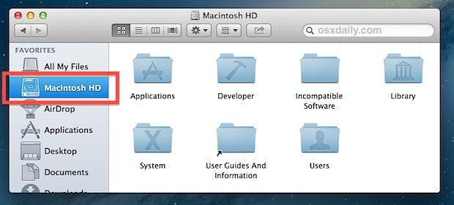
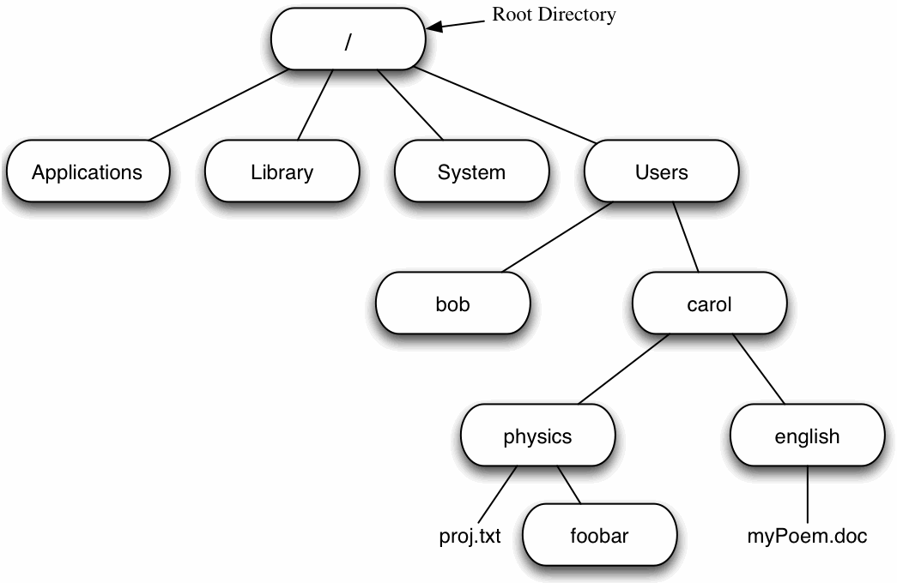
Navigating a file system (UNIX)
Volumes

Slide 4
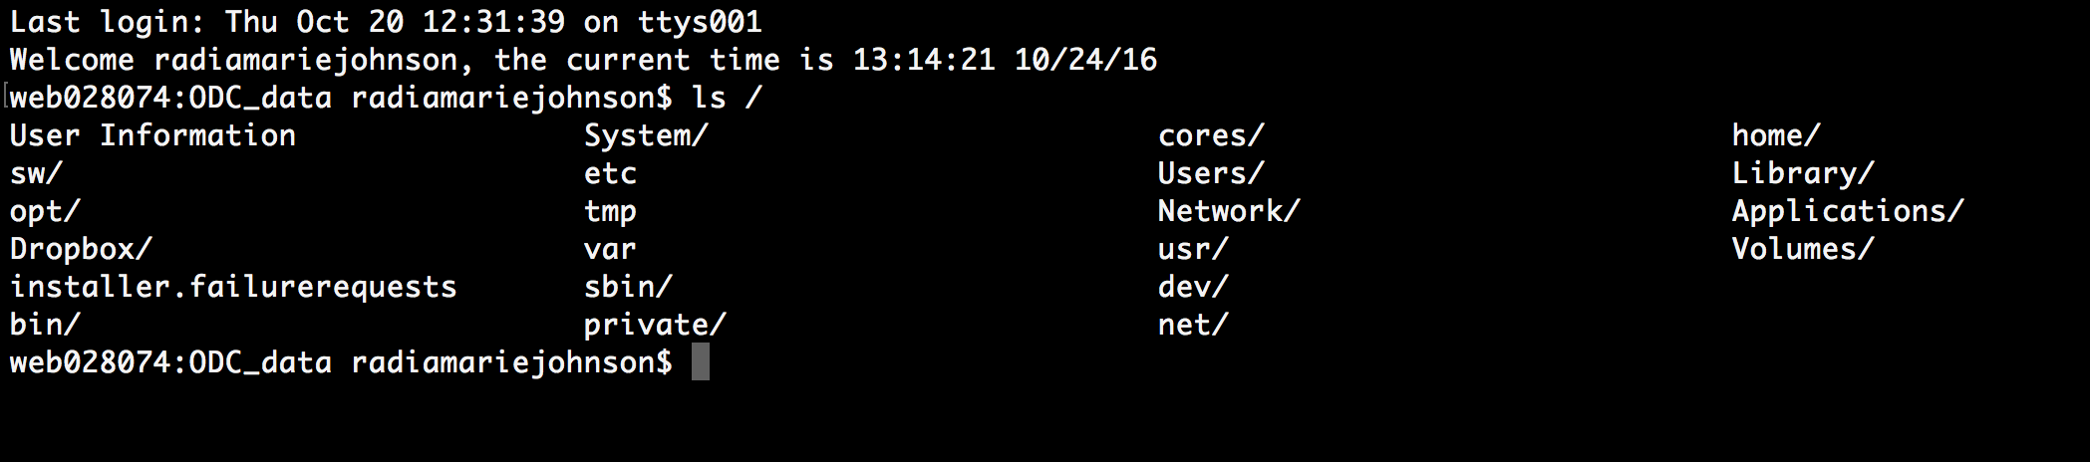
In the terminal

Slide 5
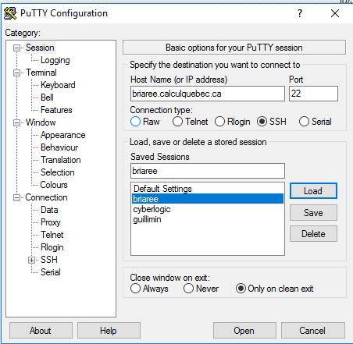
Login to cluster
Putty
Host Name: briaree.calculquebec.ca
Port: 22
Unix
ssh username@briaree.calculquebec.ca

Slide 6
Basic UNIX/LINUX command lines
pwd => print working directory
cd => change directory
ls => list
less => view files (doesn’t load the full file – best for large files)
more = > view files (prints to terminal)
man = > manual

Slide 7
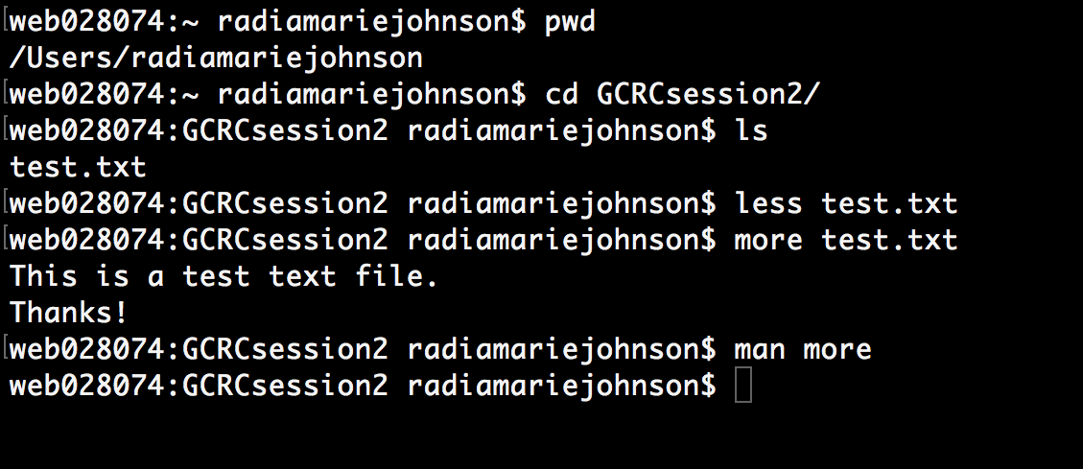
In the terminal

Slide 8
Renaming, creating and deleting files & directories
mv => rename or move file to a new location
cp => copying files
mkdir => create a new directory
rm => remove files & directories (delete forever – no trash bin)
rmdir => removes empty directories only

Slide 9
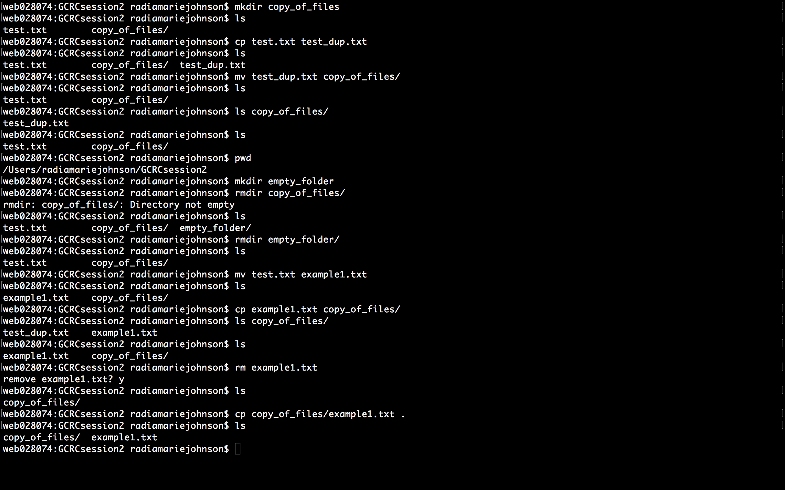
In the terminal

Slide 10
In the terminal

Slide 11
Command options
Short form (UNIX/LINUX)
ls -a
ls -l
rm -r
Long form (LINUX only)
ls --all
ls --format=long
rm --recursive

Slide 12
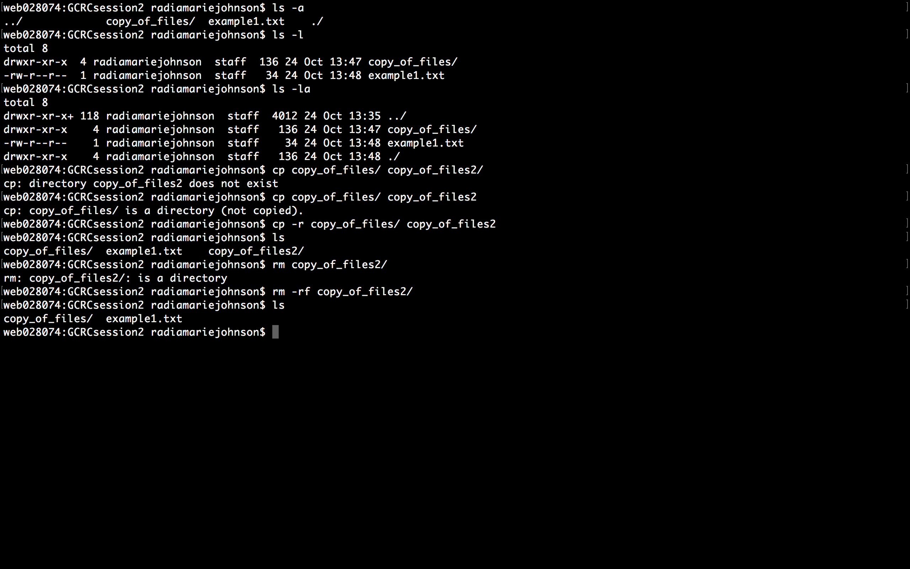
In the terminal

Slide 13
Environment variables
You can create variables -> VARIABLE=value
For example, let’s create a variable to store our GCRCsession2/ (only in current session):
FAVDIR="/Users/radiamariejohnson/GCRCsession2"
echo $FAVDIR
echo "${FAVDIR}"
Other common environment variables
$HOME or "${HOME}"
$PATH or "${PATH}"
$PWD or "${PWD}"
$SCRATCH or "${SCRATCH}"

Slide 14
In the terminal

Slide 15
Creating/running a simple BASH script
nano helloworld.sh
chmod a+x helloworld.sh
./helloworld.sh
~/GCRCsession2/helloworld.sh
$FAVDIR/helloworld.sh

Slide 16
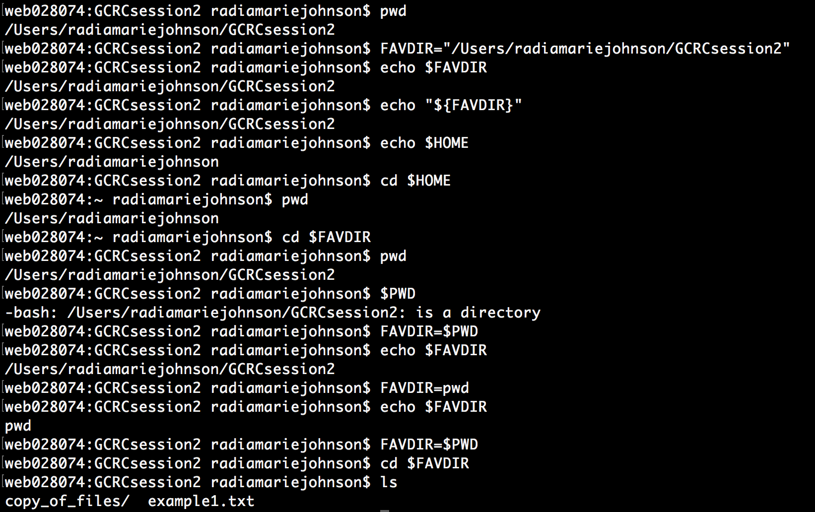
In the terminal

Slide 17
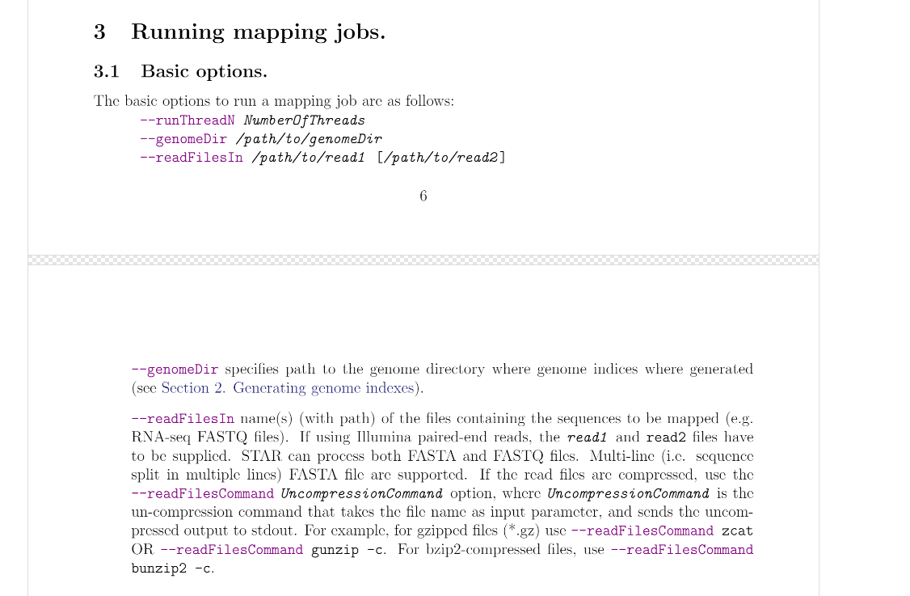
Writing a BASH script to run STAR
https://github.com/alexdobin/STAR/blob/master/doc/STARmanual.pdf

Slide 18
Using STAR Options
--genomeDir
--runThreadN
--readFilesIn
--readFilesCommand
--outFileNamePrefix
--quantMode

Slide 19
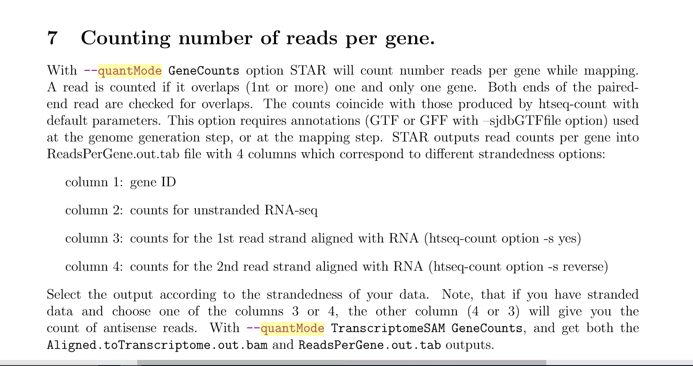
quantmode

Slide 20
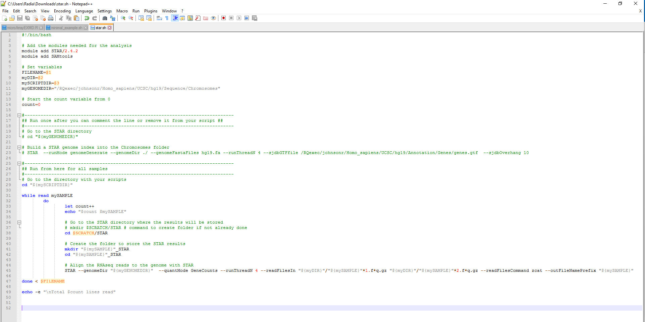

Slide 21
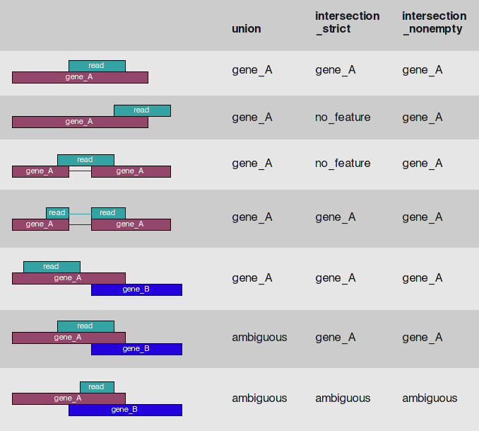
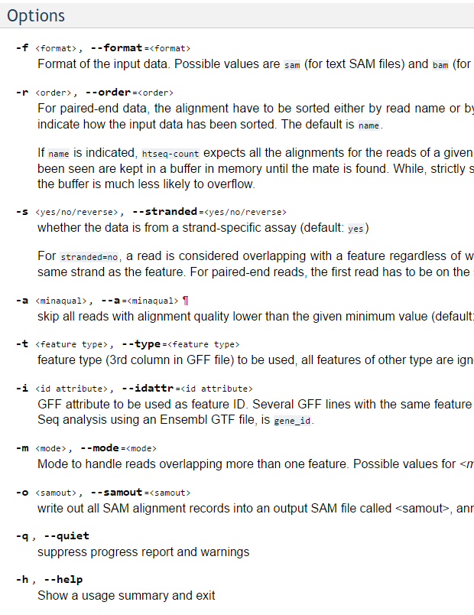
Writing a BASH script to run HTSeq
http://www-huber.embl.de/users/anders/HTSeq/doc/count.html

Slide 22
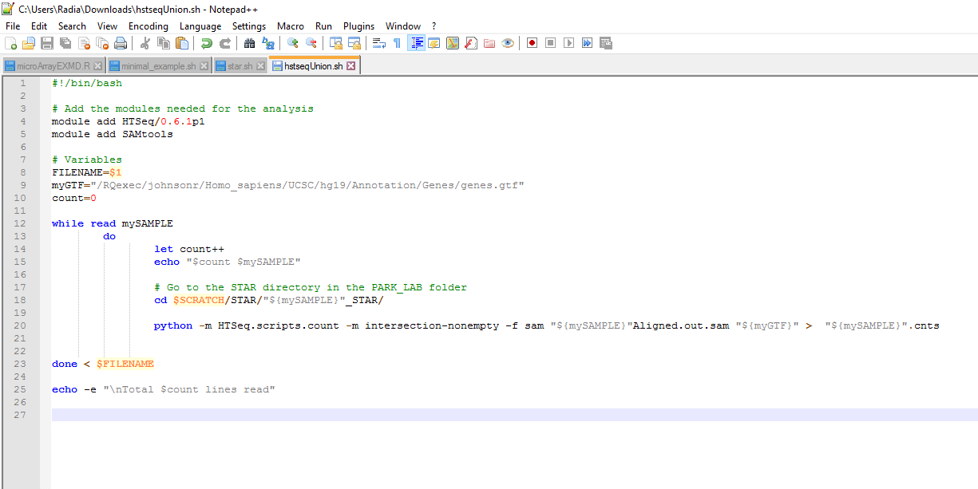

Slide 23
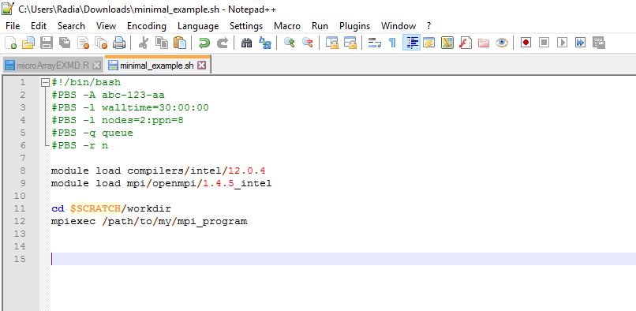
Writing a PBS script
https://wiki.calculquebec.ca/w/Ex%C3%A9cuter_une_t%C3%A2che/en

Slide 24
Launching jobs on the cluster
qsub script.pbs
qstat -u username
qdel job_id

Slide 25

Other ressources
Unix less command navigation: http://www.thegeekstuff.com/2010/02/unix-less-command-10-tips-for-effective-navigation/

